Slide 1
CSS and DESIGN – guide to basics
AKA “Oh no! You can’t use Bootstrap!”

Slide 2
Disclaimer
“Beauty lies in the eye of the beholder”
&
“It depends”

Slide 3
Contents
Why Learn the Basics?
Resources
Best Practices
Where to Start?
Questions

Slide 4

Why Learn the Basics?
You might not be able to use a pre-establish CSS framework
Avoid copyright or legal issues
Strict In-House coding standards
Understanding the basics will allow:
You to create custom styling
Build upon existing CSS frameworks
Debug issues in conflicting styles

Slide 5
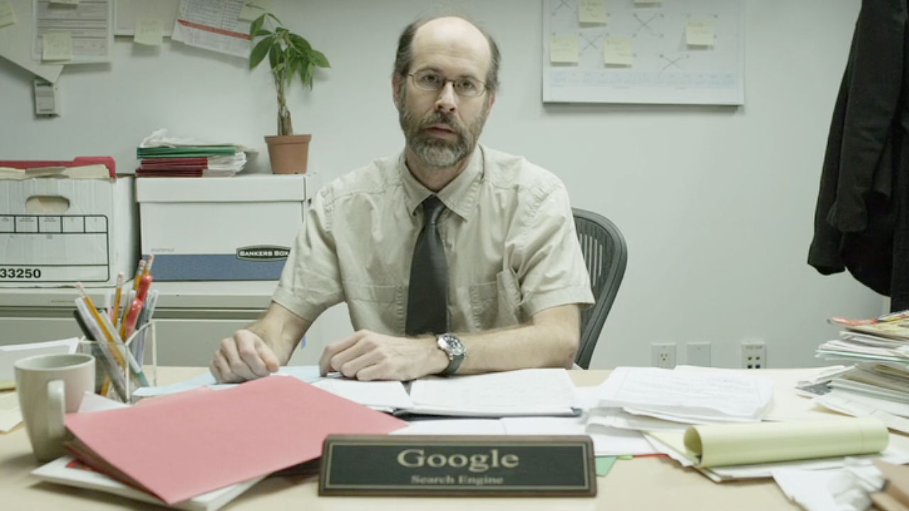
Resources
W3 Schools
XHTML (more on this in a bit)
Web Searches
Google
Yahoo
Ask Jeeves
Alta Vista

Slide 6


Resources (Cont.)
Design
Book: The Design of Everyday Things
Don Norman
Book: Don’t Make Me Think
Steve Krug
Class: Typography
Class: Advance User Interface

Slide 7

Best Practices
Simple is best - Do not overburden the user
Standards - XHTML
http://www.w3schools.com/html/html_xhtml.asp
Question yourself:
Who is your end users?
Is this readable?
Is this intuitive?

Slide 8
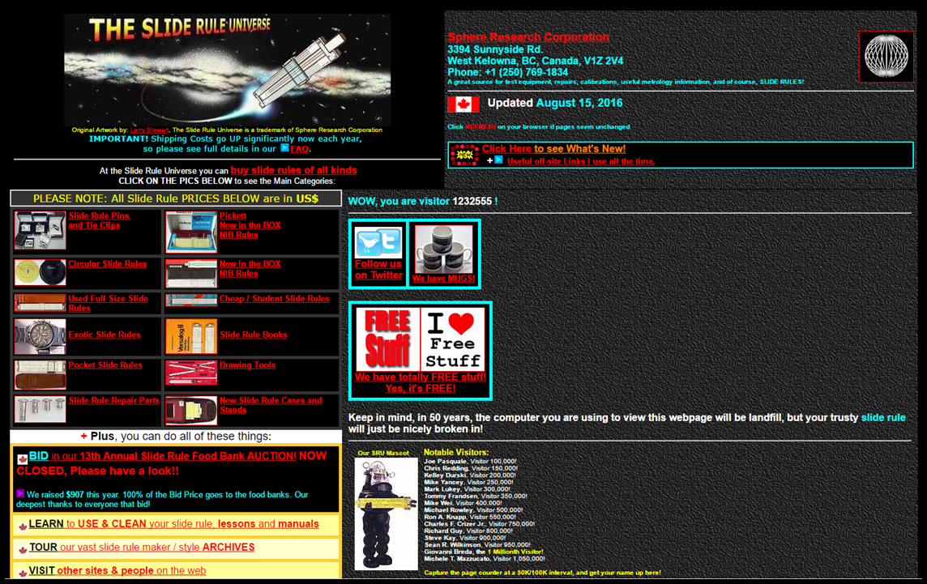
“Bad” Website Design
http://www.sphere.bc.ca/test/sruniverse.html

Slide 9

“Good” Website Design
https://www.dropbox.com/
https://4rsmokehouse.com/

Slide 10
Basics (1 of 3)
Calling CSS
External File
<head> <link rel="stylesheet" type="text/css" href=“style.css"> </head>
Internal
<head> <style> .classname { } </style> </head>
Inline
<div style=“display: block;”></div>

Slide 11
Basics (2 of 3)
Selectors
General - <div>
div { }
Class - <div class=“myClass”></div>
.myClass { }
ID - <div id=“myID”></div>
#myID { }
Media Queries
Screen Size
@media screen and (min-width: 979px) { }
Print view
@media print { }

Slide 12
Basics (3 of 3)
Event CSS - .myClass:<eventname>
Hover
Active
Visited
Focus
Attributes – Ex: <a href=http://www.google.com>
a[href]
a[href=http]
Even More!
http://www.w3schools.com/cssref/css_selectors.asp
Live Demo?

Slide 13
Questions?

